Slide 1
COSC3503 Section 1 Operating Systems Chapter 3 Processes
Doug Lim

Slide 2
Chapter 3 Processes
Objectives
To introduce the notion of a process -- a program in execution, which forms the basis of all computation
To describe the various features of processes, including scheduling, creation and termination, and communication
To explore interprocess communication using shared memory and message passing
To describe communication in client-server systems

Slide 3
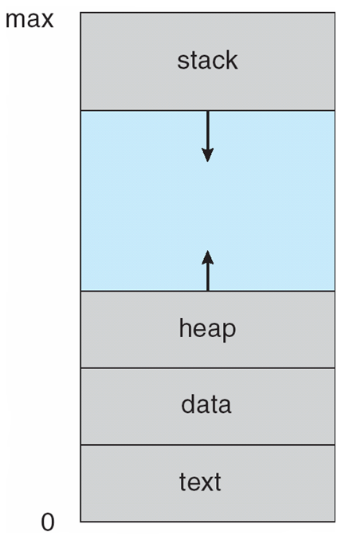
What is a process?
Textbook uses the terms job and process almost interchangeably
Process – a program in execution; process execution must progress in sequential fashion
Multiple parts
The program code, also called text section
Current activity including program counter, processor registers (Process Control Block – PCB)
Stack containing temporary data
Function parameters, return addresses, local variables
Data section containing global variables
Heap containing memory dynamically allocated during run time

Slide 4
Process Execution
Program is passive entity stored on disk (executable file), process is active
Program becomes process when executable file loaded into memory
Execution of program started via GUI mouse clicks, command line entry of its name, etc
One program can be several processes
Consider multiple users executing the same program
Fork

Slide 5
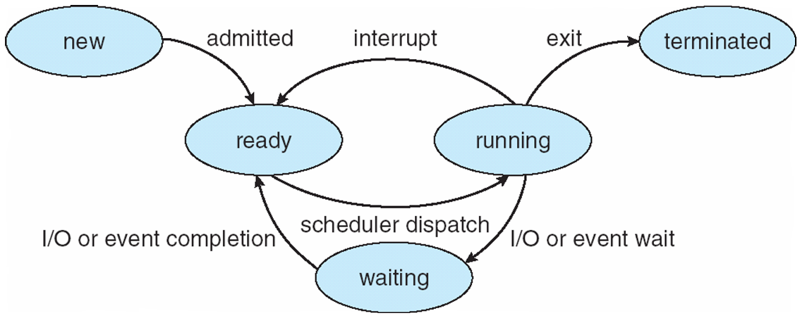
Process State
Notes:
As a process executes, it changes state
new: The process is being created
ready: The process is waiting to be assigned to a processor
running: Instructions are being executed
waiting: The process is waiting for some event to occur
terminated: The process has finished execution

Slide 6
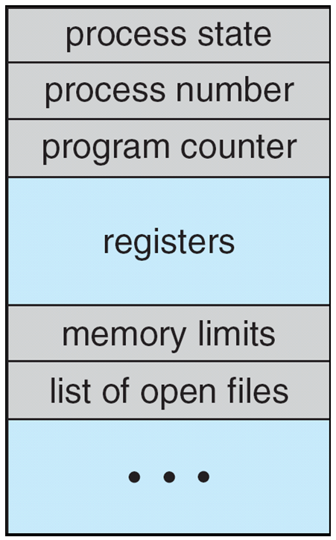
Process Control Block (PCB)
Information associated with each process
(also called task control block)
Process state – running, waiting, etc
Program counter – location of instruction to next execute
CPU registers – contents of all process-centric registers
CPU scheduling information- priorities, scheduling queue pointers
Memory-management information – memory allocated to the process
Accounting information – CPU used, clock time elapsed since start, time limits
I/O status information – I/O devices allocated to process, list of open files

Slide 7
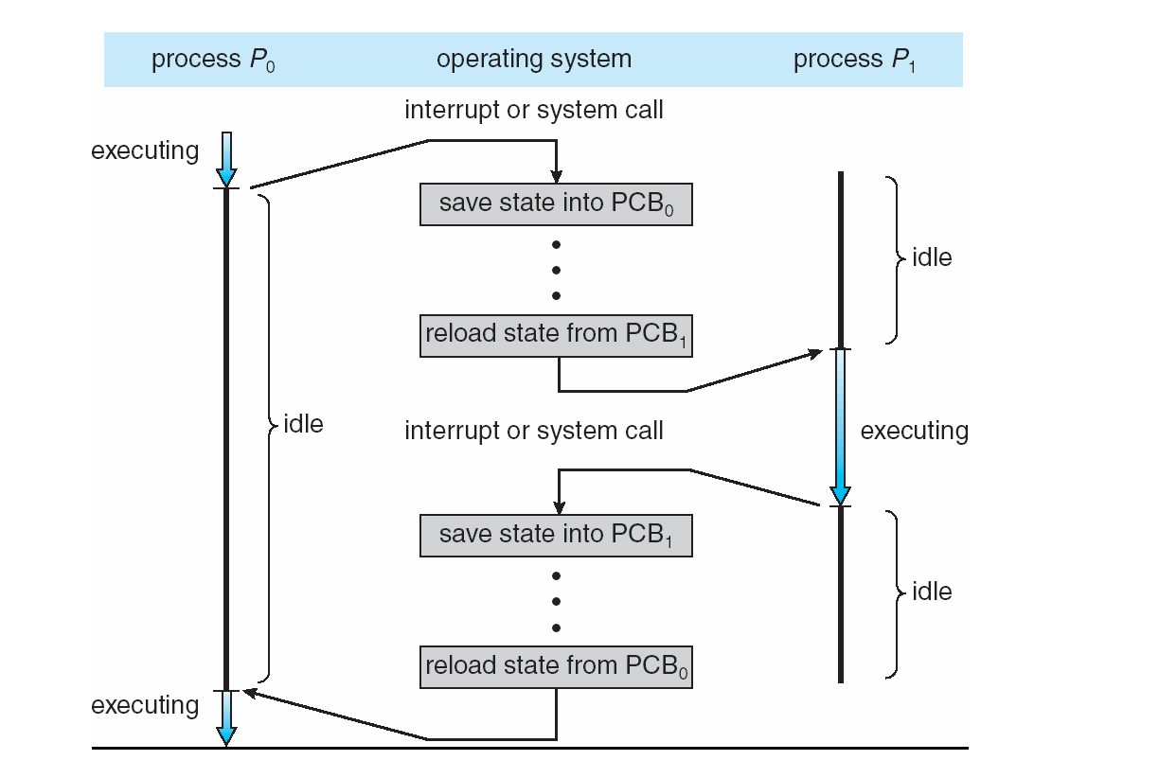
CPU Switch From Process to Process (Context Switch)

Slide 8
Threads (A Coming Attraction)
So far, process has a single thread of execution
Consider having multiple program counters per process
Multiple locations can execute at once
Multiple threads of control -> threads
Must then have storage for thread details, multiple program counters in PCB
See next chapter

Slide 9
Process Scheduling
Maximize CPU use, quickly switch processes onto CPU for time sharing
Process scheduler selects among available processes for next execution on CPU
Maintains scheduling queues of processes
Job queue – set of all processes in the system
Ready queue – set of all processes residing in main memory, ready and waiting to execute
Device queues – set of processes waiting for an I/O device
Processes migrate among the various queues

Slide 10
Context Switch
When CPU switches to another process, the system must save the state of the old process and load the saved state for the new process via a context switch
Context of a process represented in the PCB
Context-switch time is overhead; the system does no useful work while switching
The more complex the OS and the PCB ➔ the longer the context switch
Time dependent on hardware support
Some hardware provides multiple sets of registers per CPU ➔ multiple contexts loaded at once

Slide 11
Process Creation
Parent process create children processes, which, in turn create other processes, forming a tree of processes
Generally, process identified and managed via a process identifier (pid)
Resource sharing options
Parent and children share all resources
Children share subset of parent’s resources
Parent and child share no resources
Execution options
Parent and children execute concurrently
Parent waits until children terminate

Slide 12
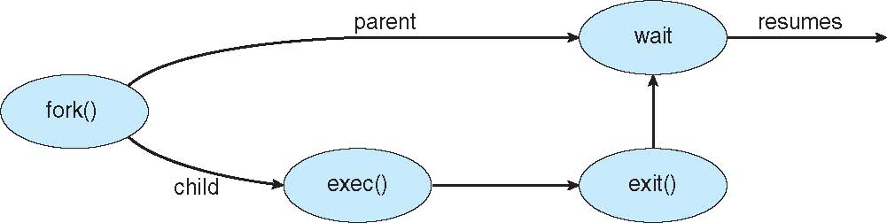
Process Creation Example
Address space
Child duplicate of parent
Child has a program loaded into it
UNIX examples
fork() system call creates new process
exec() system call used after a fork() to replace the process’ memory space with a new program

Slide 13
Process Termination
Process executes last statement and then asks the operating system to delete it using the exit() system call.
Returns status data from child to parent (via wait())
Process’ resources are deallocated by operating system
Parent may terminate the execution of children processes using the abort() system call. Some reasons for doing so:
Child has exceeded allocated resources
Task assigned to child is no longer required
The parent is exiting, and the operating systems does not allow a child to continue if its parent terminates

Slide 14
Process Termination
Some operating systems do not allow child to exists if its parent has terminated. If a process terminates, then all its children must also be terminated.
cascading termination. All children, grandchildren, etc. are terminated.
The termination is initiated by the operating system.
The parent process may wait for termination of a child process by using the wait()system call. The call returns status information and the pid of the terminated process
pid = wait(&status);
If no parent waiting (did not invoke wait()) process is a zombie
If parent terminated without invoking wait , process is an orphan
Notes:
When a child exits, some process must wait on it to get its exit code. That exit code is stored in the process table until this happens. The act of reading that exit code is called "reaping" the child. Between the time a child exits and is reaped, it is called a zombie. (The whole nomenclature is a bit gruesome when you think about it; I recommend not thinking about it too much.)
Zombies only occupy space in the process table. They take no memory or CPU. However, the process table is a finite resource, and excessive zombies can fill it, meaning that no other processes can launch. Beyond that, they are bothersome clutter, and should be strongly avoided.
If a process exits with children still running (and doesn't kill its children; the metaphor continues to be bizarre), those children are orphans. Orphaned children are immediately "adopted" by init (actually, I think most people call this "reparenting," but "adoption" seems to carry the metaphor better). An orphan is just a process. It will use whatever resources it uses. It is reasonable to say that it is not an "orphan" at all since it has a parent, but I've heard them called that often.
init automatically reaps its children (adopted or otherwise). So if you exit without cleaning up your children, then they will not become zombies (at least not for more than a moment).
But long-lived zombies exist. What are they? They're the former children of an existing process that hasn't reaped them. The process may be hung. Or it may be poorly written and forgets to reap its children. Or maybe it's overloaded and hasn't gotten around to it. Or whatever. But for some reason, the parent process continues to exist (so they aren't orphans), and they haven't been waited on, so they live on as zombies in the process table.
So if you see zombies for longer than a moment, then it means that there is something wrong with the parent process, and something should be done to improve that program.

Slide 15
Zombie Process
// A C program to demonstrate Zombie Process.
// Child becomes Zombie as parent is sleeping
// when child process exits.
#include <stdlib.h>
#include <sys/types.h>
#include <unistd.h>
int main()
{
// Fork returns process id
// in parent process
pid_t child_pid = fork();
// Parent process
if (child_pid > 0)
sleep(50);
// Child process
else
exit(0);
return 0;
}
Notes:
When a child exits, some process must wait on it to get its exit code. That exit code is stored in the process table until this happens. The act of reading that exit code is called "reaping" the child. Between the time a child exits and is reaped, it is called a zombie. (The whole nomenclature is a bit gruesome when you think about it; I recommend not thinking about it too much.)
Zombies only occupy space in the process table. They take no memory or CPU. However, the process table is a finite resource, and excessive zombies can fill it, meaning that no other processes can launch. Beyond that, they are bothersome clutter, and should be strongly avoided.
If a process exits with children still running (and doesn't kill its children; the metaphor continues to be bizarre), those children are orphans. Orphaned children are immediately "adopted" by init (actually, I think most people call this "reparenting," but "adoption" seems to carry the metaphor better). An orphan is just a process. It will use whatever resources it uses. It is reasonable to say that it is not an "orphan" at all since it has a parent, but I've heard them called that often.
init automatically reaps its children (adopted or otherwise). So if you exit without cleaning up your children, then they will not become zombies (at least not for more than a moment).
But long-lived zombies exist. What are they? They're the former children of an existing process that hasn't reaped them. The process may be hung. Or it may be poorly written and forgets to reap its children. Or maybe it's overloaded and hasn't gotten around to it. Or whatever. But for some reason, the parent process continues to exist (so they aren't orphans), and they haven't been waited on, so they live on as zombies in the process table.
So if you see zombies for longer than a moment, then it means that there is something wrong with the parent process, and something should be done to improve that program.

Slide 16
Orphan Process
// A C program to demonstrate Orphan Process.
// Parent process finishes execution while the
// child process is running. The child process
// becomes orphan.
#include<stdio.h>
#include <sys/types.h>
#include <unistd.h>
int main()
{
// Create a child process
int pid = fork();
if (pid > 0)
printf("in parent process");
// Note that pid is 0 in child process
// and negative if fork() fails
else if (pid == 0)
{
sleep(30);
printf("in child process");
}
return 0;
}
Notes:
When a child exits, some process must wait on it to get its exit code. That exit code is stored in the process table until this happens. The act of reading that exit code is called "reaping" the child. Between the time a child exits and is reaped, it is called a zombie. (The whole nomenclature is a bit gruesome when you think about it; I recommend not thinking about it too much.)
Zombies only occupy space in the process table. They take no memory or CPU. However, the process table is a finite resource, and excessive zombies can fill it, meaning that no other processes can launch. Beyond that, they are bothersome clutter, and should be strongly avoided.
If a process exits with children still running (and doesn't kill its children; the metaphor continues to be bizarre), those children are orphans. Orphaned children are immediately "adopted" by init (actually, I think most people call this "reparenting," but "adoption" seems to carry the metaphor better). An orphan is just a process. It will use whatever resources it uses. It is reasonable to say that it is not an "orphan" at all since it has a parent, but I've heard them called that often.
init automatically reaps its children (adopted or otherwise). So if you exit without cleaning up your children, then they will not become zombies (at least not for more than a moment).
But long-lived zombies exist. What are they? They're the former children of an existing process that hasn't reaped them. The process may be hung. Or it may be poorly written and forgets to reap its children. Or maybe it's overloaded and hasn't gotten around to it. Or whatever. But for some reason, the parent process continues to exist (so they aren't orphans), and they haven't been waited on, so they live on as zombies in the process table.
So if you see zombies for longer than a moment, then it means that there is something wrong with the parent process, and something should be done to improve that program.

Slide 17
Interprocess Communication
Processes within a system may be independent or cooperating
Cooperating process can affect or be affected by other processes, including sharing data
Reasons for cooperating processes:
Information sharing
Computation speedup
Modularity
Convenience
Cooperating processes need interprocess communication (IPC)
Two models of IPC
Shared memory
Message passing

Slide 18
Communications Models
Notes:
Message Passing
Shared Memory

Slide 19
Producer-Consumer Problem
Paradigm for cooperating processes, producer process produces information that is consumed by a consumer process
unbounded-buffer places no practical limit on the size of the buffer
bounded-buffer assumes that there is a fixed buffer size

Slide 20
Synchronization
Message passing may be either blocking or non-blocking
Blocking is considered synchronous
Blocking send -- the sender is blocked until the message is received
Blocking receive -- the receiver is blocked until a message is available
Non-blocking is considered asynchronous
Non-blocking send -- the sender sends the message and continue
Non-blocking receive -- the receiver receives:
A valid message, or A Null message
Different combinations possible
If both send and receive are blocking, we have a rendezvous

Slide 21
Communications in Client-Server Systems
Sockets
Remote Procedure Calls
Pipes
Remote Method Invocation (Java)

Slide 22
Sockets
A socket is defined as an endpoint for communication
Concatenation of IP address and port – a number included at start of message packet to differentiate network services on a host
The socket 161.25.19.8:1625 refers to port 1625 on host 161.25.19.8
Communication consists between a pair of sockets
All ports below 1024 are well known, used for standard services
Special IP address 127.0.0.1 (loopback) to refer to system on which process is running

Slide 23
Pipes
Acts as a conduit allowing two processes to communicate
Issues:
Is communication unidirectional or bidirectional?
In the case of two-way communication, is it half or full-duplex?
Must there exist a relationship (i.e., parent-child) between the communicating processes?
Can the pipes be used over a network?
Ordinary pipes – cannot be accessed from outside the process that created it. Typically, a parent process creates a pipe and uses it to communicate with a child process that it created.
Named pipes – can be accessed without a parent-child relationship.

Slide 24
Communications in Client-Server Systems
Sockets
Remote Procedure Calls
Pipes
Remote Method Invocation (Java)

Slide 25
Sockets
A socket is defined as an endpoint for communication
Concatenation of IP address and port – a number included at start of message packet to differentiate network services on a host
The socket 161.25.19.8:1625 refers to port 1625 on host 161.25.19.8
Communication consists between a pair of sockets
All ports below 1024 are well known, used for standard services
Special IP address 127.0.0.1 (loopback) to refer to system on which process is running

Slide 26
Pipes
Acts as a conduit allowing two processes to communicate
Issues:
Is communication unidirectional or bidirectional?
In the case of two-way communication, is it half or full-duplex?
Must there exist a relationship (i.e., parent-child) between the communicating processes?
Can the pipes be used over a network?
Ordinary pipes – cannot be accessed from outside the process that created it. Typically, a parent process creates a pipe and uses it to communicate with a child process that it created.
Reading and writing to ordinary pipes on both UNIX and Windows systems can be performed like ordinary file I/O.
Named pipes – can be accessed without a parent-child relationship.

